Slide 1
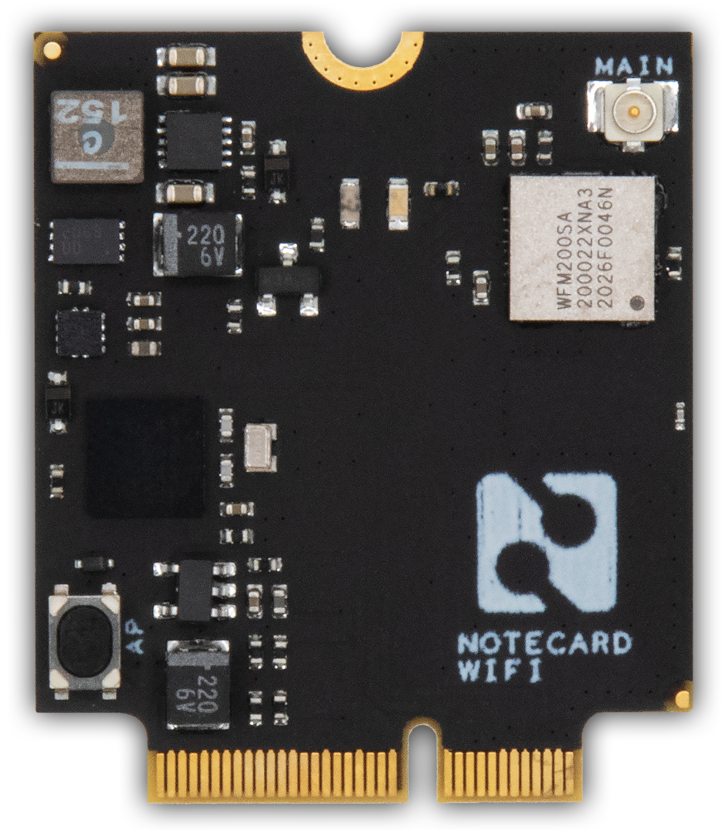
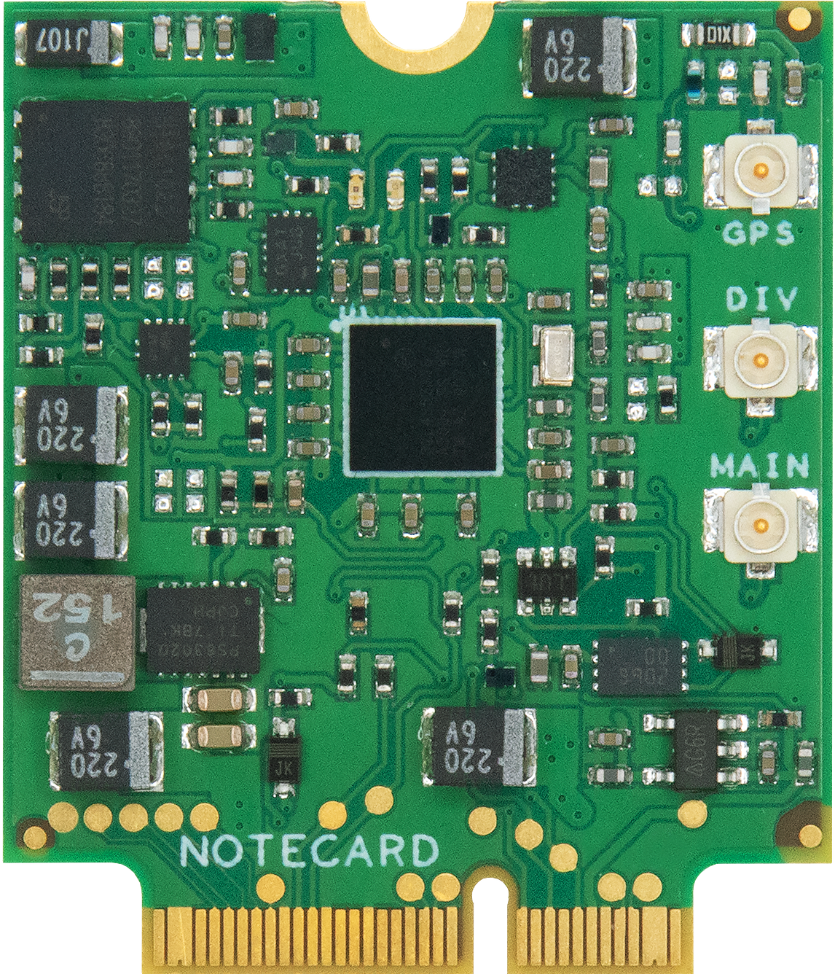

Introducing Dev-Friendly
Wireless with the Notecard!
Rob Lauer
Director of Developer Relations

Slide 2
Complexity kills. It sucks the life out of developers, it makes products difficult to plan, build, and test.
Ray Ozzie – CEO of Blues Wireless

Slide 3
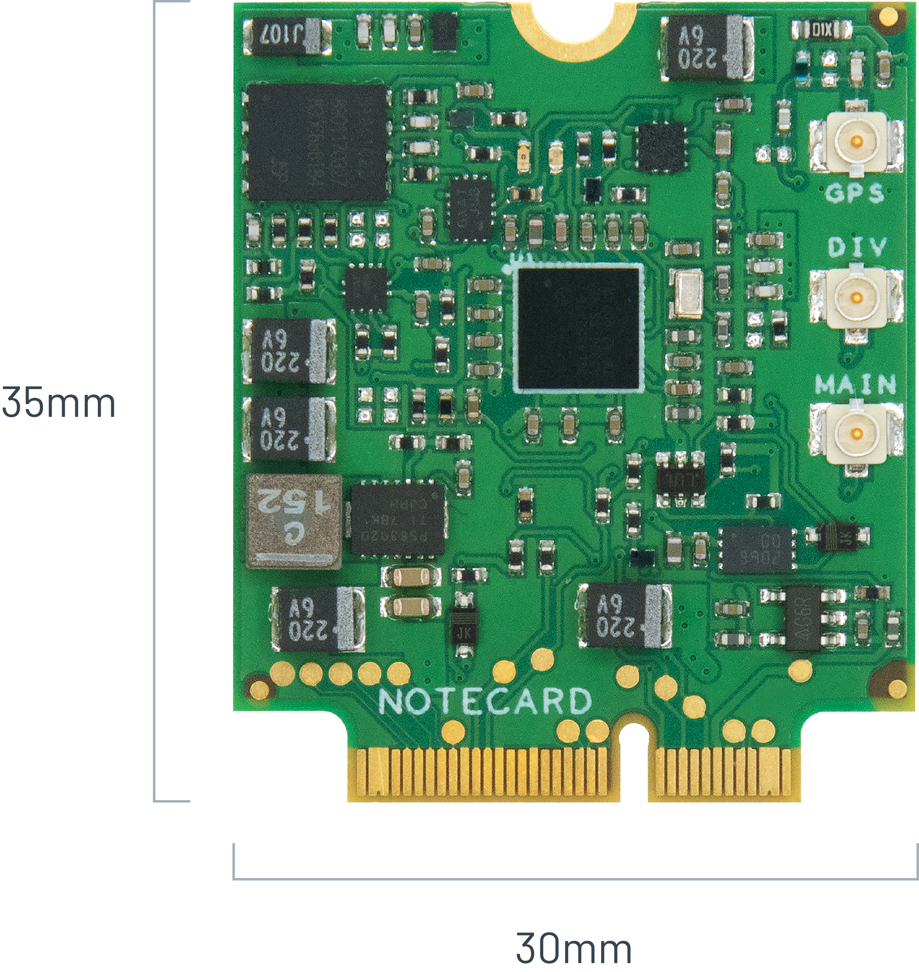
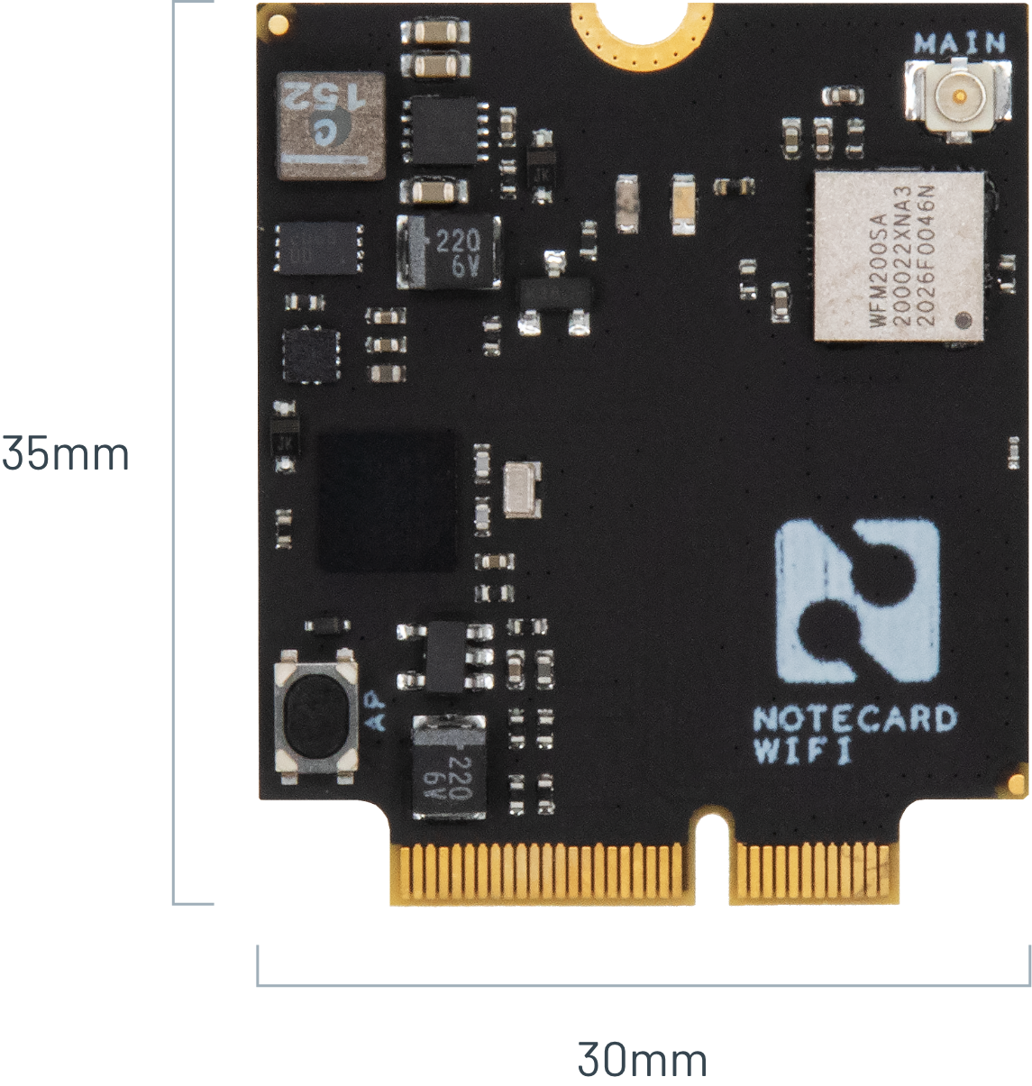

Section Agenda
Intro to the Notecard and Blues Wireless
Lab: Hands-on Wireless IoT
Lab: Collect Sensor Data and Send to Cloud

Slide 5
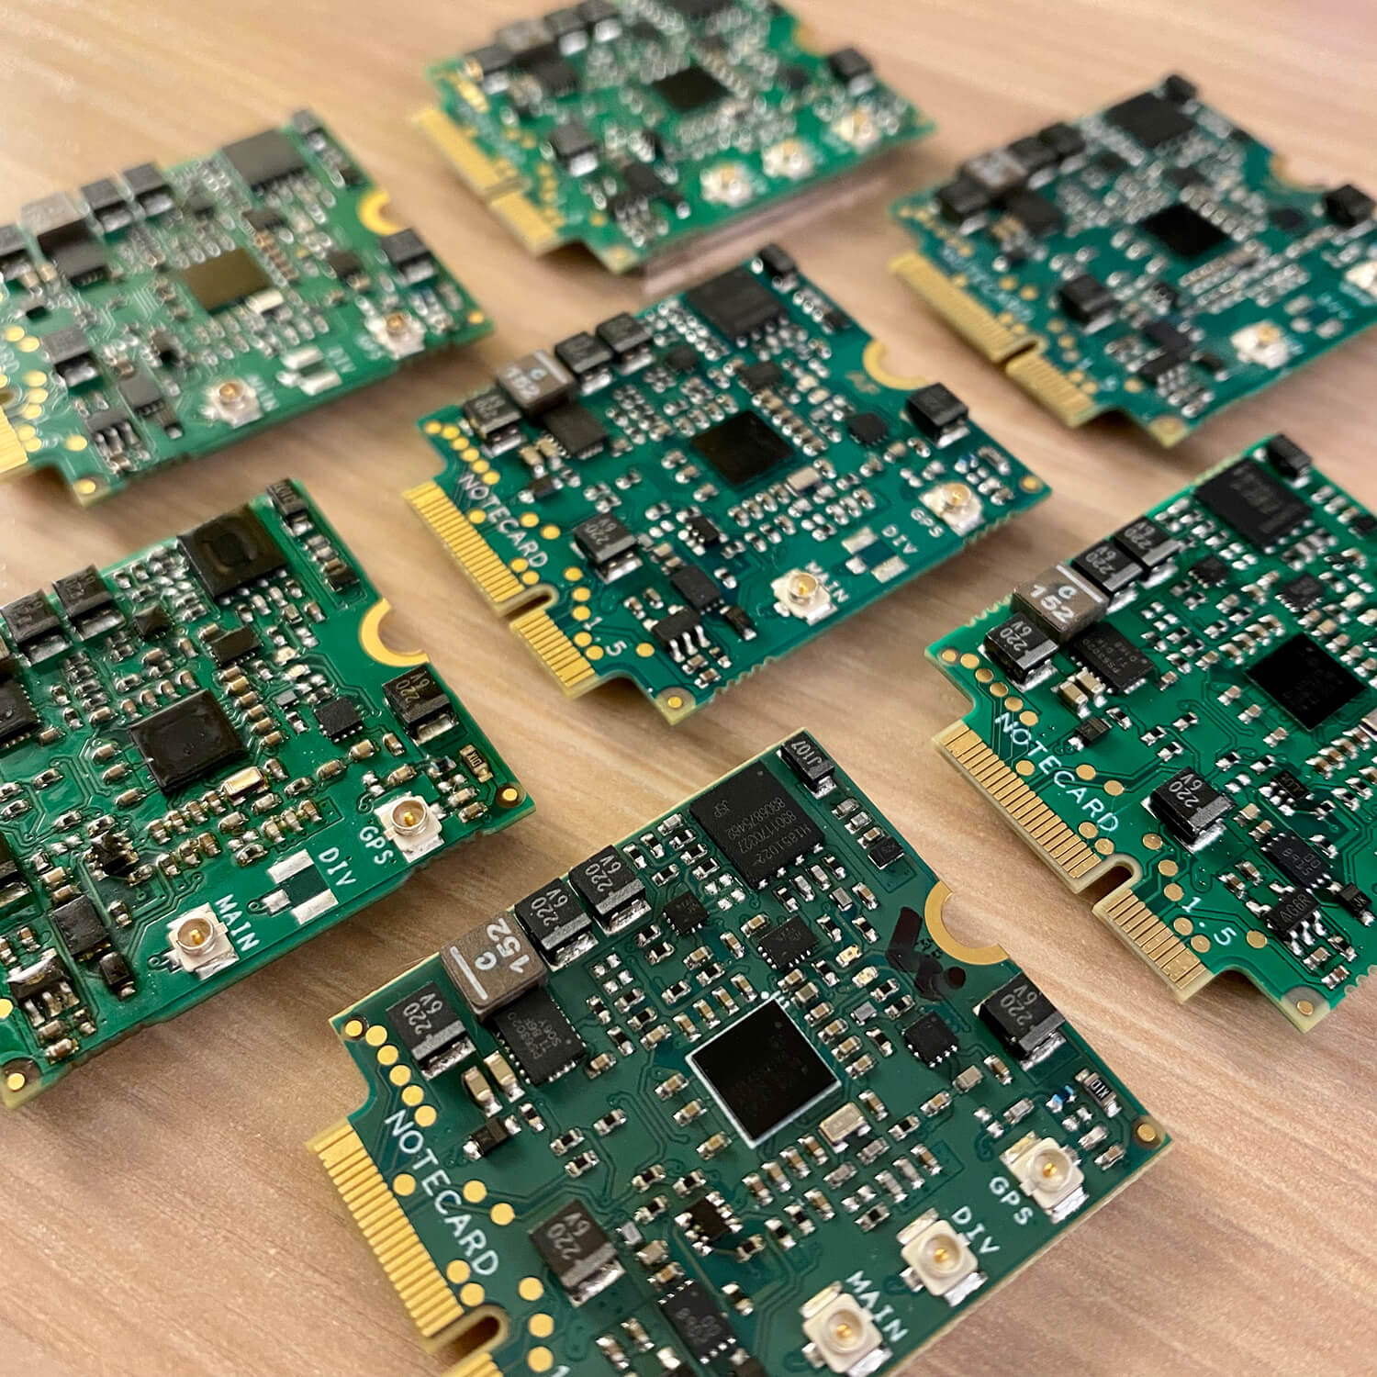
”Making wireless IoT easier for developers
and more affordable for all”

Slide 6
Easy for developers and affordable for all.
🔒 Securing your data from device to cloud
🔋 Building zero-config low-power hardware
👩‍💻 Providing an unmatched developer experience

Slide 7
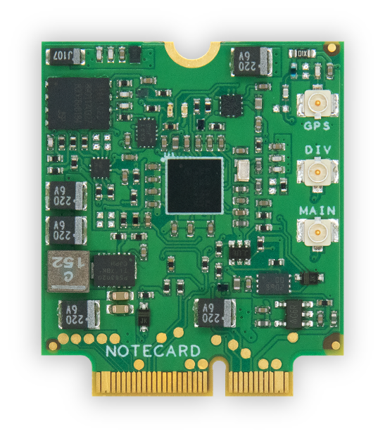
Notecard
Low-power system-on-module
Global cellular/GPS or Wi-Fi
500MB cell data + 10 years service
JSON-based API
Python, Go, Arduino, C/C++
Cellular: NB-IoT, LTE-M, Cat-1

Slide 8
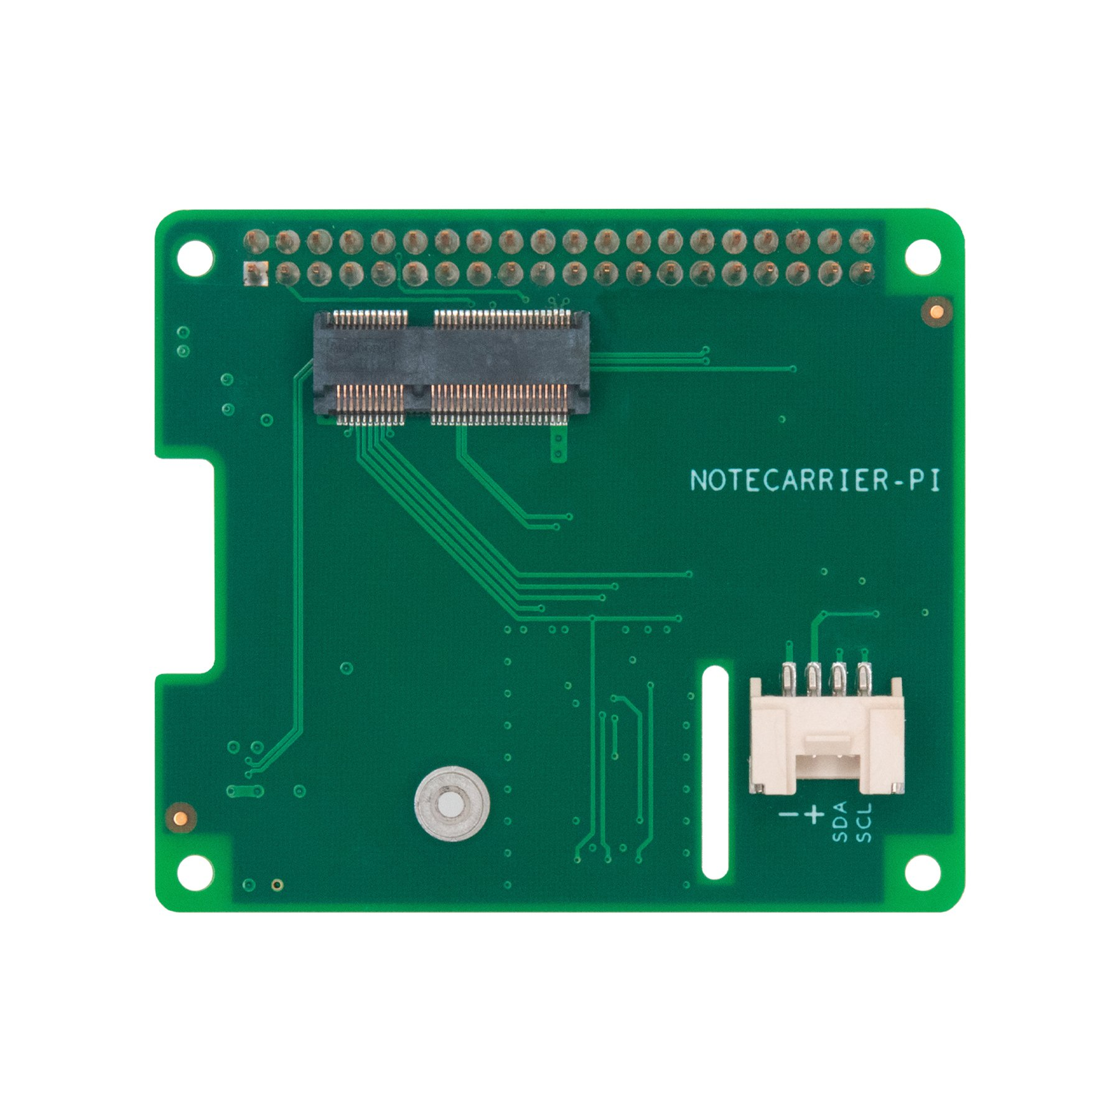
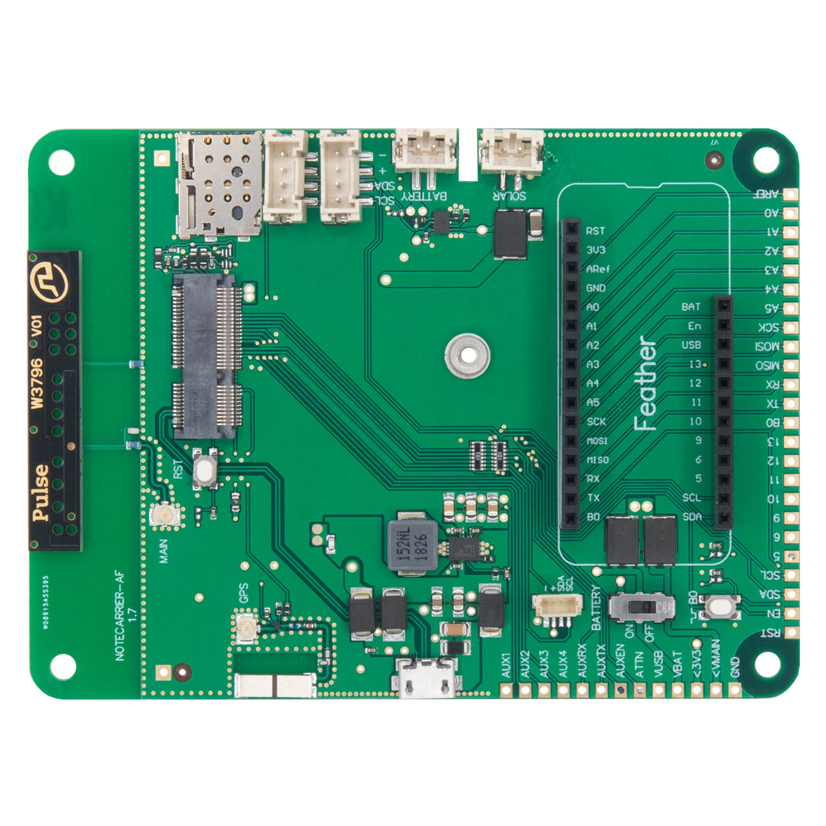
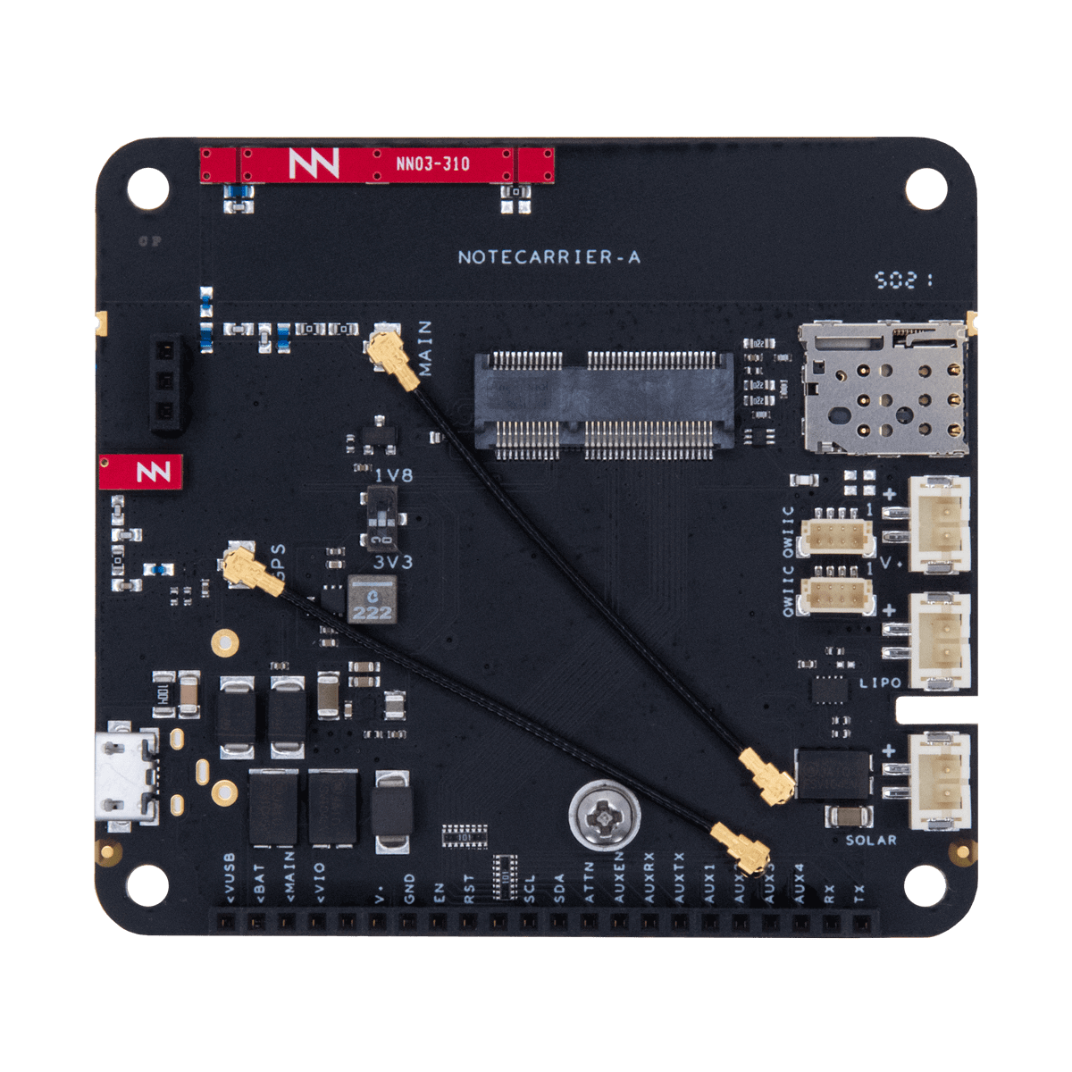
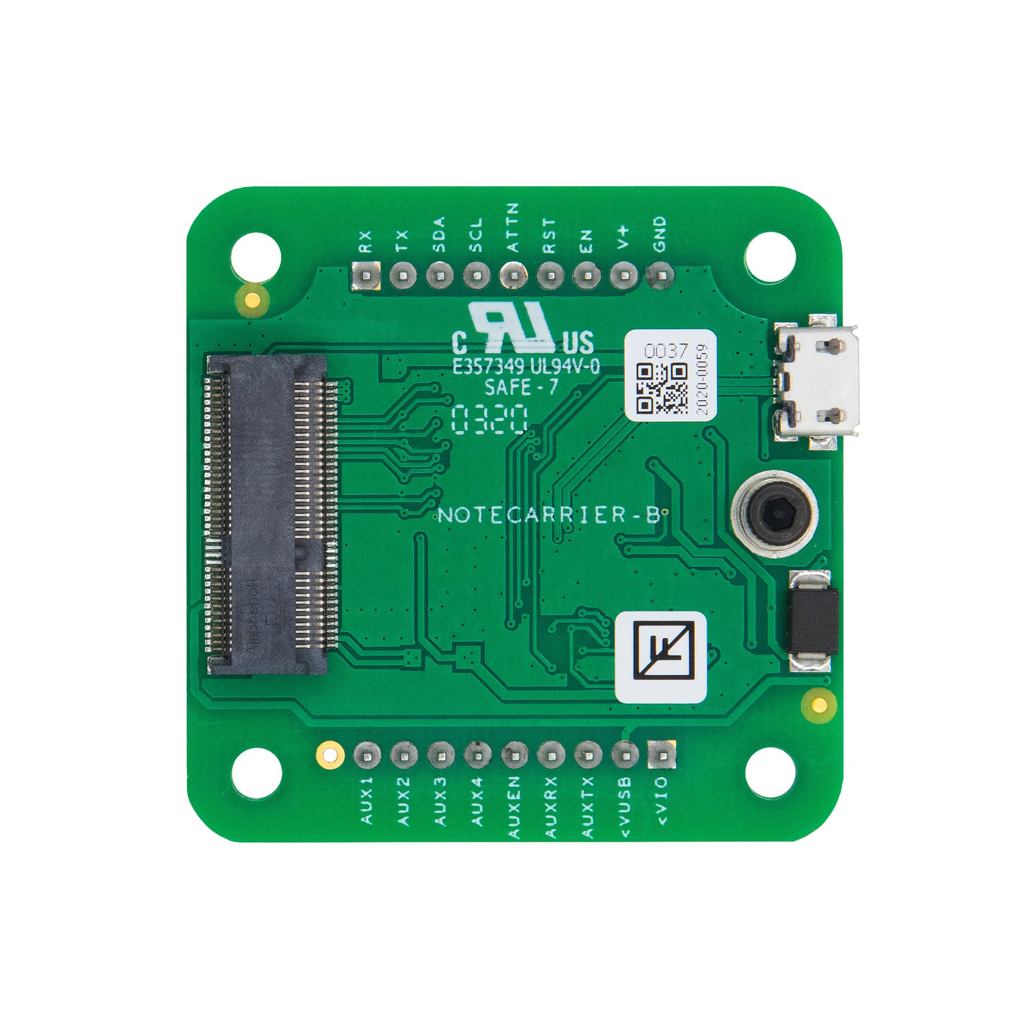
Notecarrier
Dev boards for easy prototyping
Notecarrier for every scenario:
AF – Feather-compatible socket
A – Any MCU, onboard antennas
B – Small form factor
Pi – Raspberry Pi SBC

Slide 9
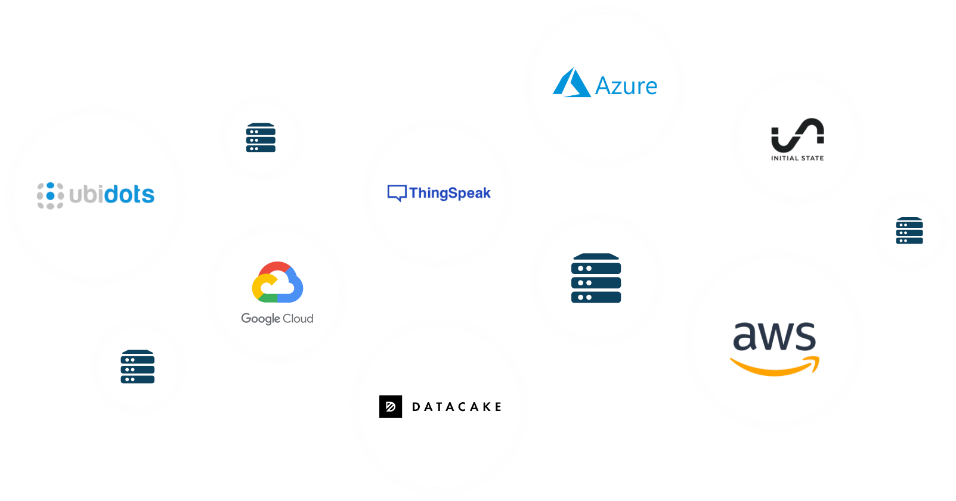
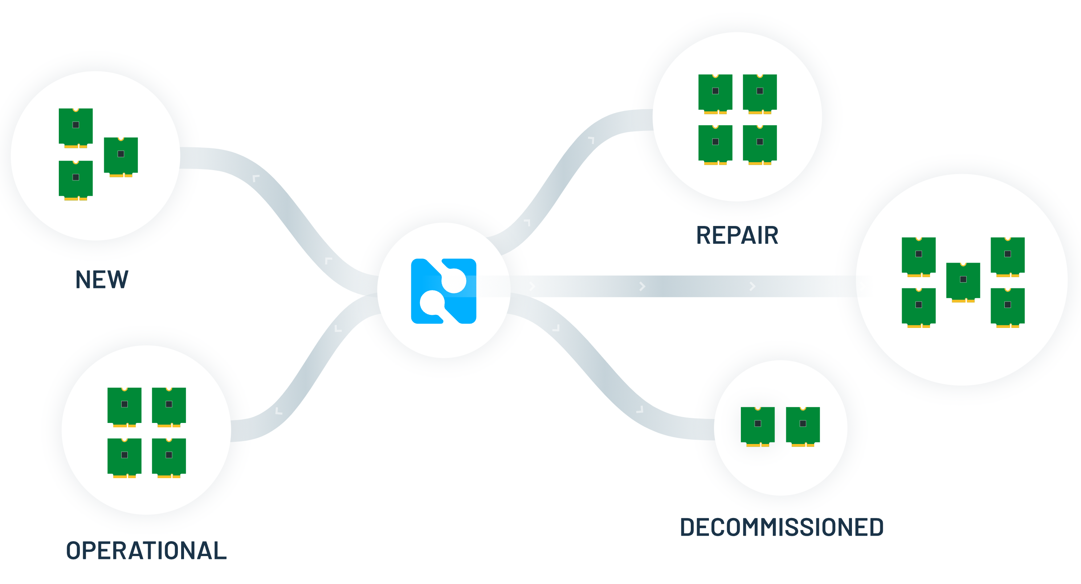
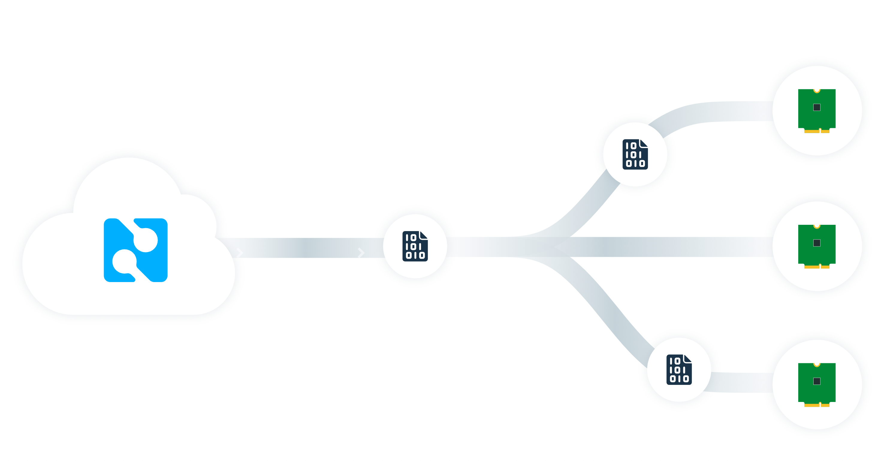
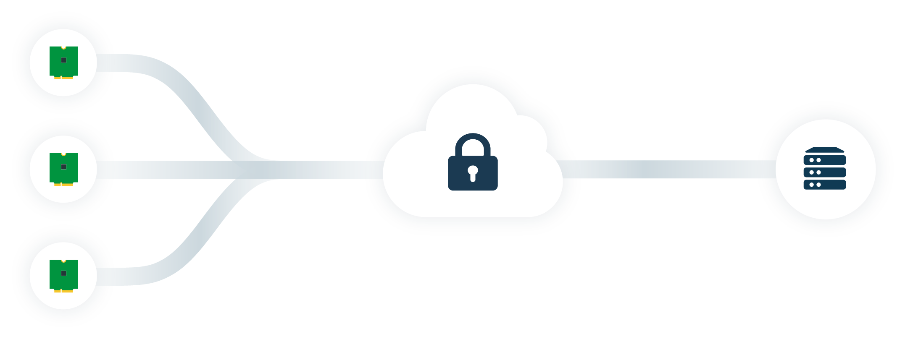
Notehub
Route data to any cloud app
Manage fleets of devices
OTA MCU/Notecard firmware updates
Secure communications

Slide 10
Example: card.location API
Request
{ "req": "card.location" }
Response
{
"status": "GPS updated (58 sec, 41dB SNR, 9 sats),
"mode": "periodic",
"lat": 42.577600,
"lon": -70.871340,
"time": 1598554399
}

Slide 11
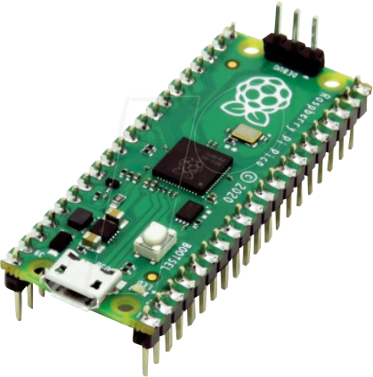
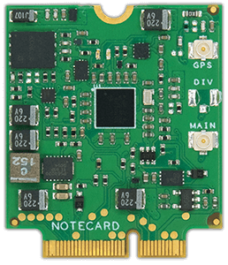




Outbound Communication (from MCU to Cloud)
{JSON}
{JSON}
🔒📡️🔒
Your MCU/SBC
Your Sensors
Your Language
Cellular/Wi-Fi
Notecard
Blues Wireless
Notehub.io
Any Cloud
Arduino
C/C++
Python
JSON
req = {"req": "note.add"}
req["file"] = "sensors.qo"
req["body"] = {"temp": 72.22 }
req["sync"] = True
rsp = card.Transaction(req)
{
"file": "data.qo",
"temp": 27.3,
"when": 1644268443,
"lat": 42.11,
"lon": -88.32
"device": "dev:89347"
}

Slide 12
Inbound Communication (from Cloud to MCU)
{JSON}
{JSON}
🔒📡️🔒
Your MCU/SBC
Your Sensors
Your Language
Cellular/Wi-Fi
Notecard
Blues Wireless
Notehub.io
Any Cloud
Arduino
C/C++
Python
JSON
req = {"req": "note.get"}
req["file"] = "data.qi"
req["delete"] = True
rsp = card.Transaction(req)
{
"file": "data.qi",
"sample_freq": 5,
"notify": true
}

Slide 13
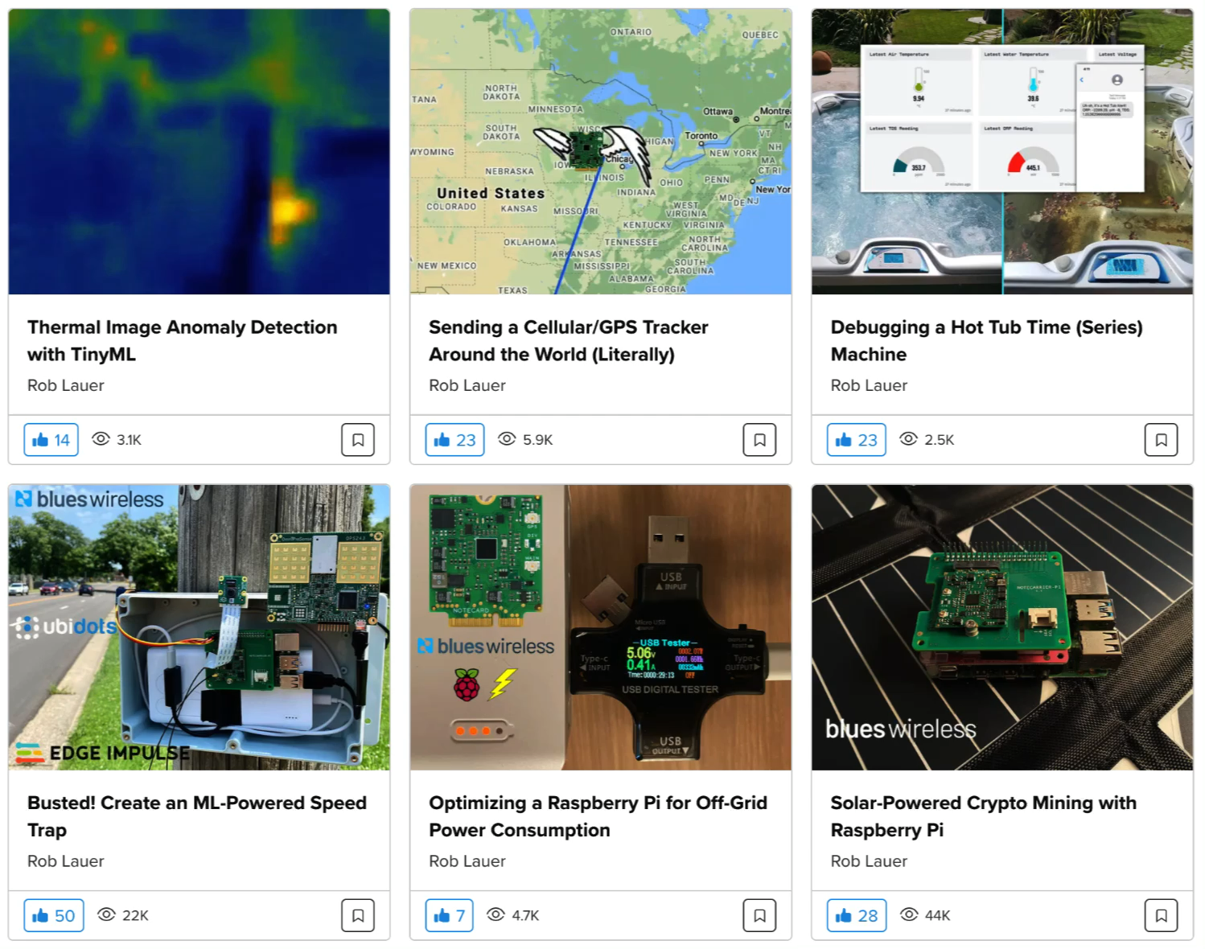
hackster.io/blues-wireless

Slide 14
Lab! 🔨
Chromium-based Browser
(e.g. Chrome, Edge, Brave)
Micro USB Cable
The Hammer of Blues

Slide 15
Lab! 🔨
Arduino IDE + STM32Cube
VS Code + PlatformIO
Small PlatformIO Clone sensor project Walk through code | Medium Arduino or PlatformIO Follow dev.blues.io tut Use pseudo sensor | Large Arduino or PlatformIO Follow dev.blues.io tut Add real sensors
bit.ly/blues-hammer

